Slide 1
The Society of
Women Engineers
The University of Texas at El Paso
Third General Meeting
November 11, 2015

Slide 2
Agenda
November 11, 2015
Who is SWE?
Semester Recap
Sister Program Announcements
Upcoming Events

Slide 3
Who is SWE?

Slide 4
Society of Women Engineers
Mission
“Stimulate women to achieve full potential in careers as engineers and leaders, expand the image of the engineering profession as a positive force in improving the quality of life, and demonstrate the value of diversity.”
Integrity • Inclusive Environment • Mutual Support
• Professional Excellence • Trust •

Slide 5
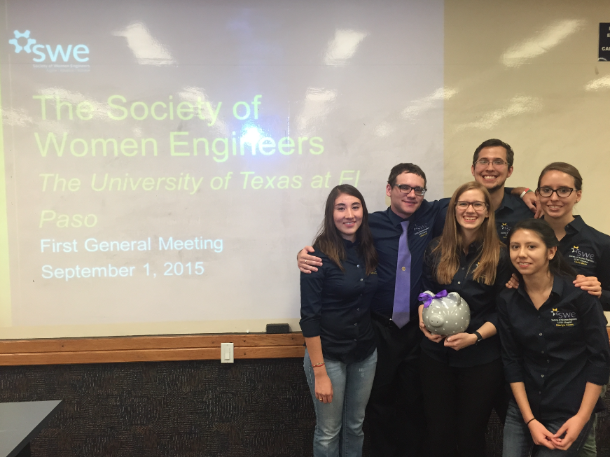
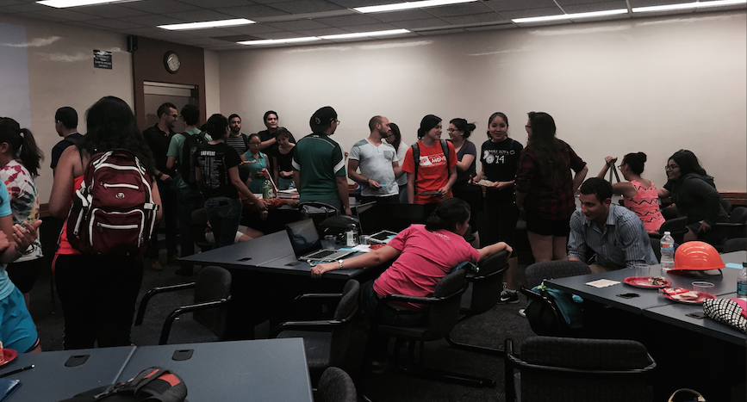
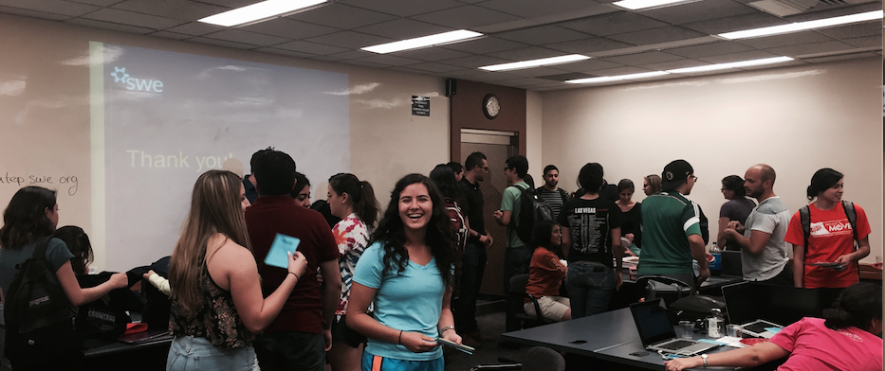
Semester Recap

Slide 6
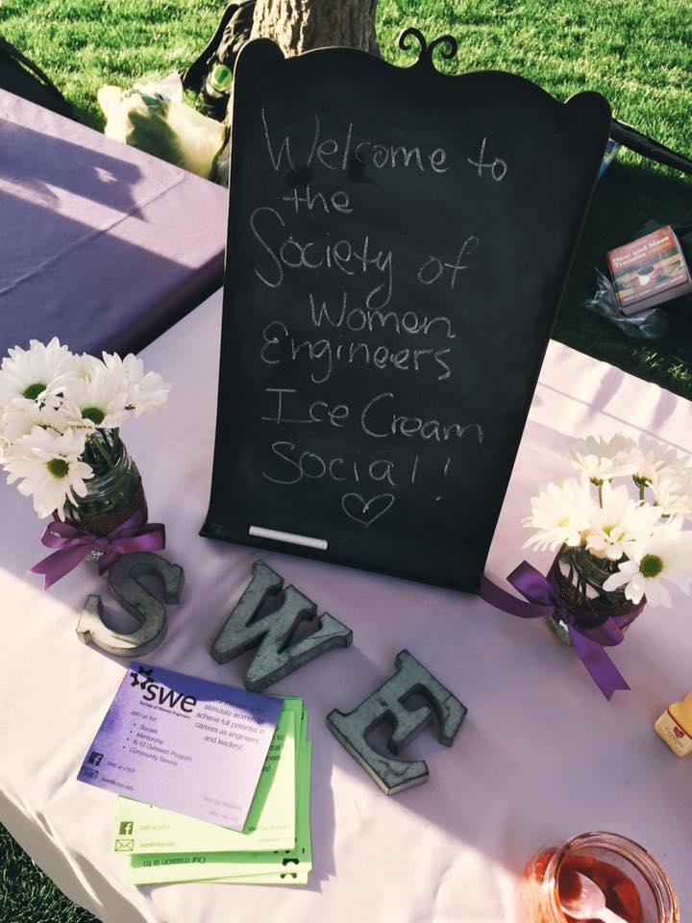
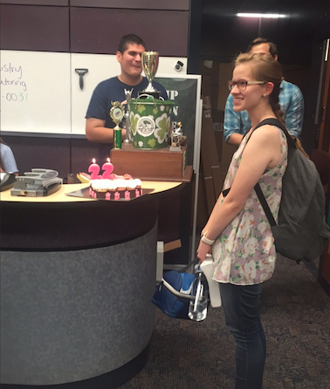
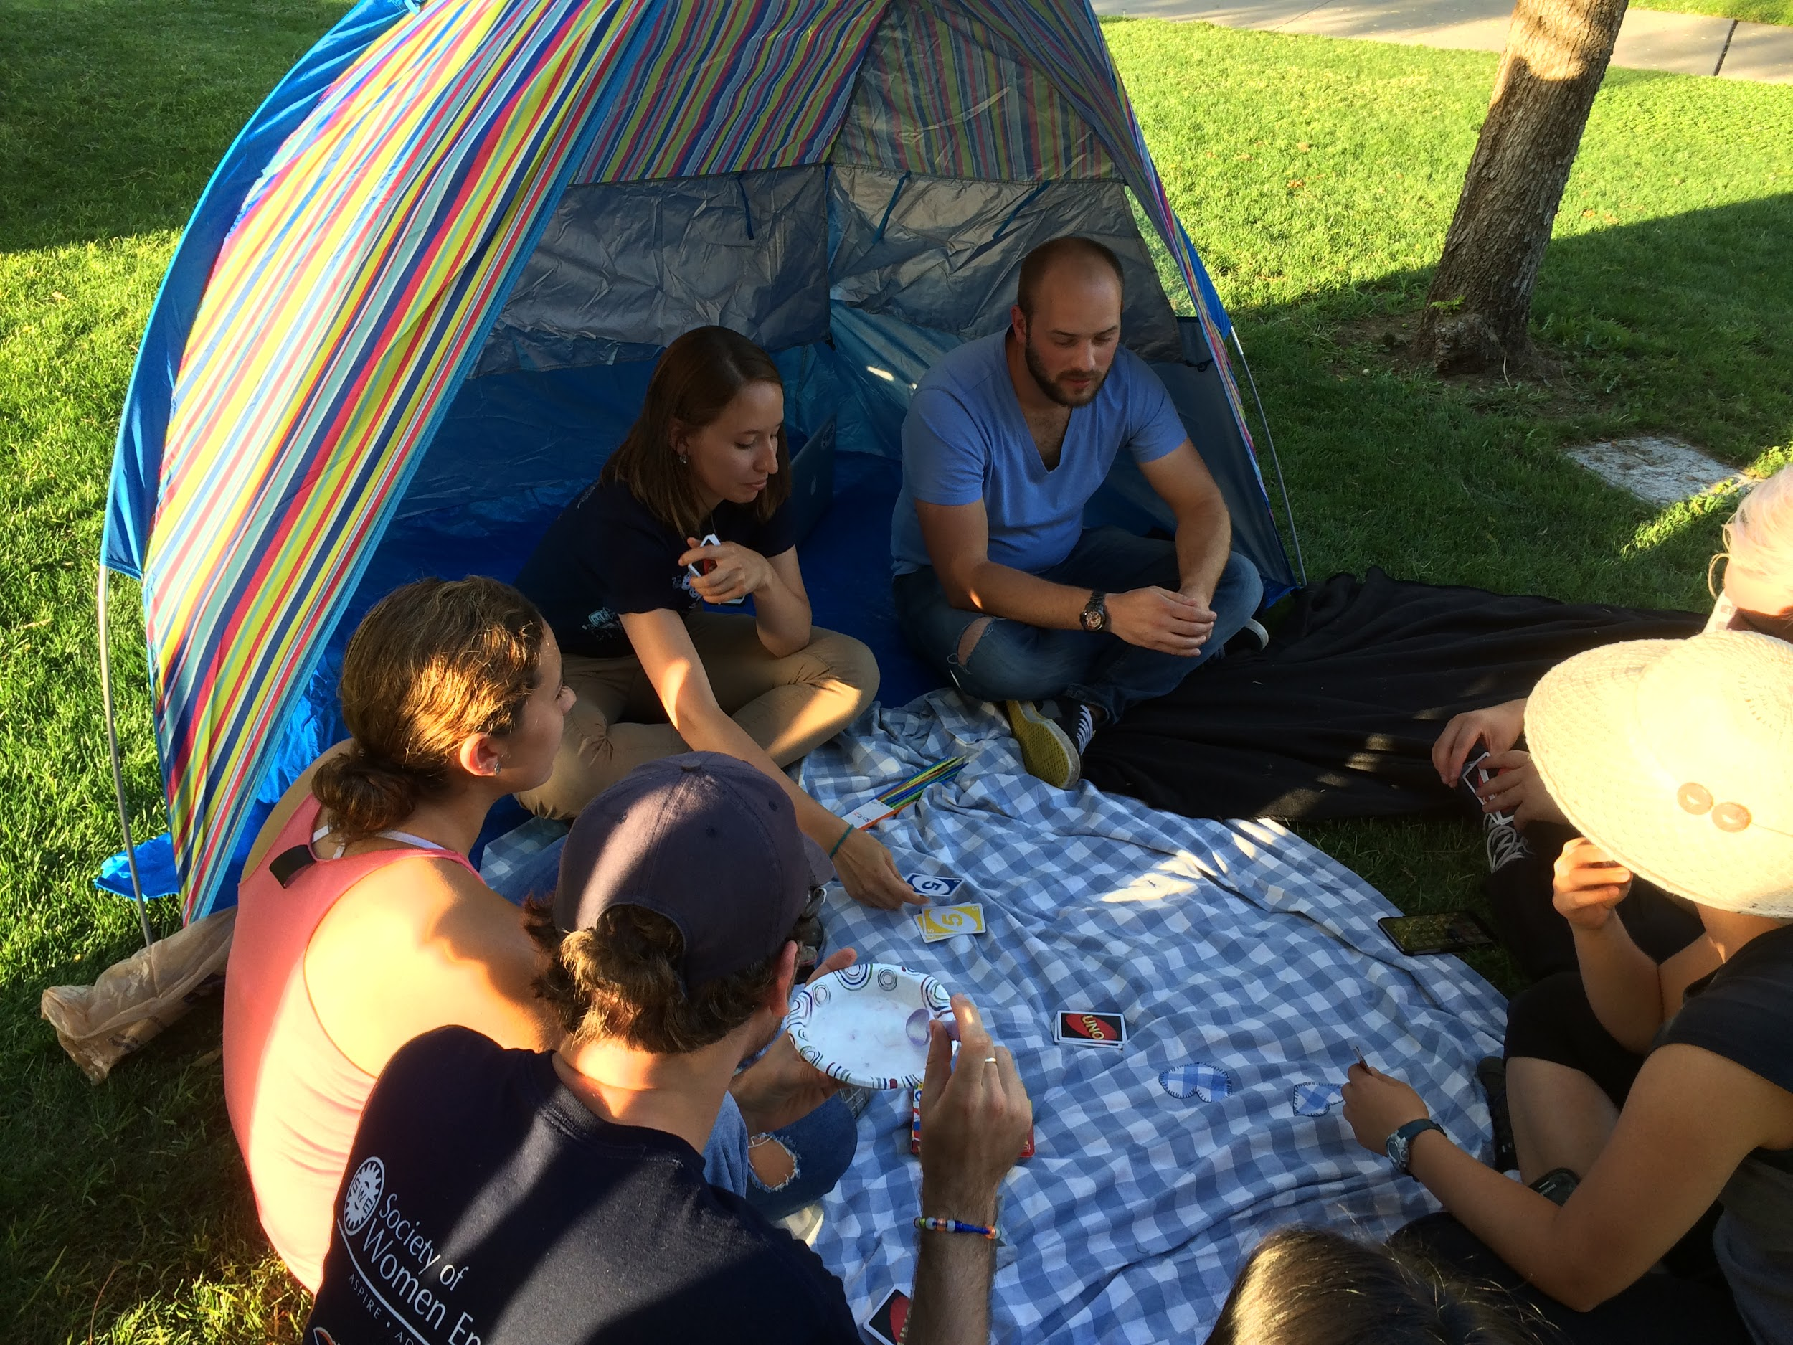
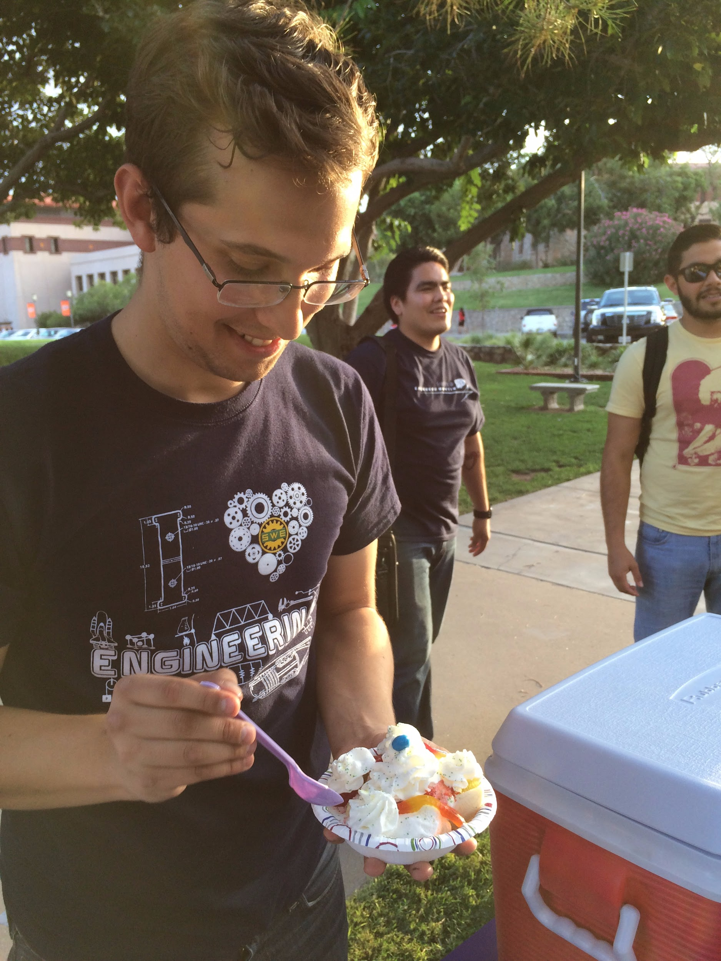

Slide 7
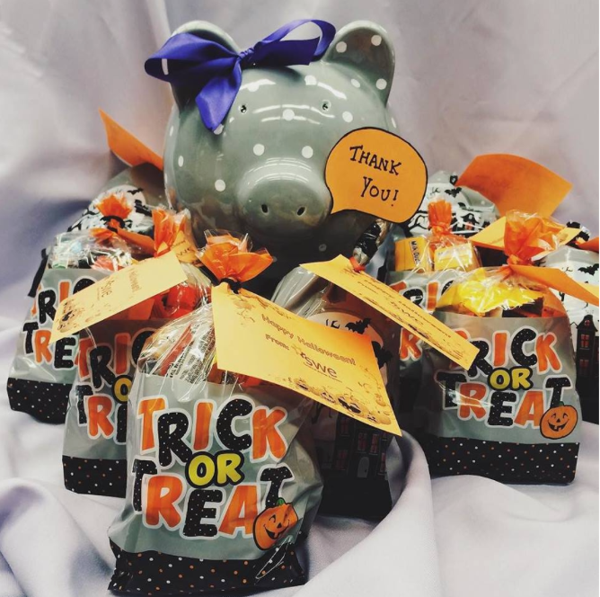
Thank you for your donations!!!
We filled 40 treat bags AND had left over candy!

Slide 8
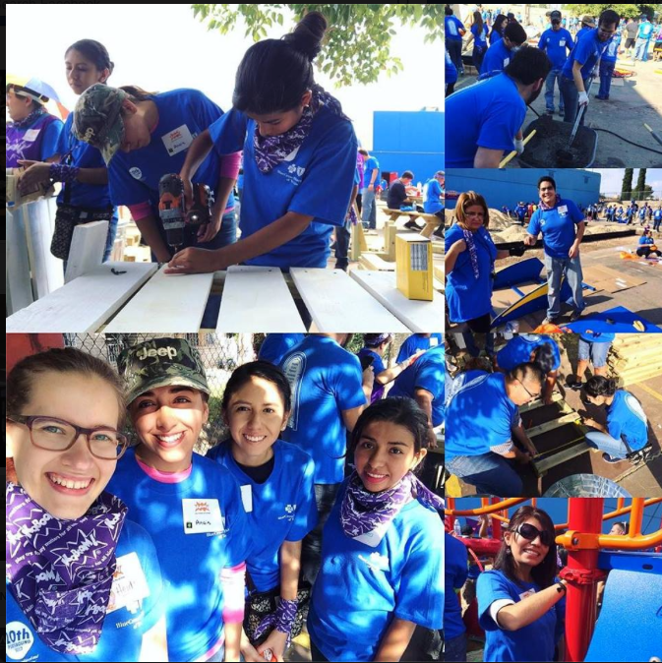
We built a playground!

Slide 9
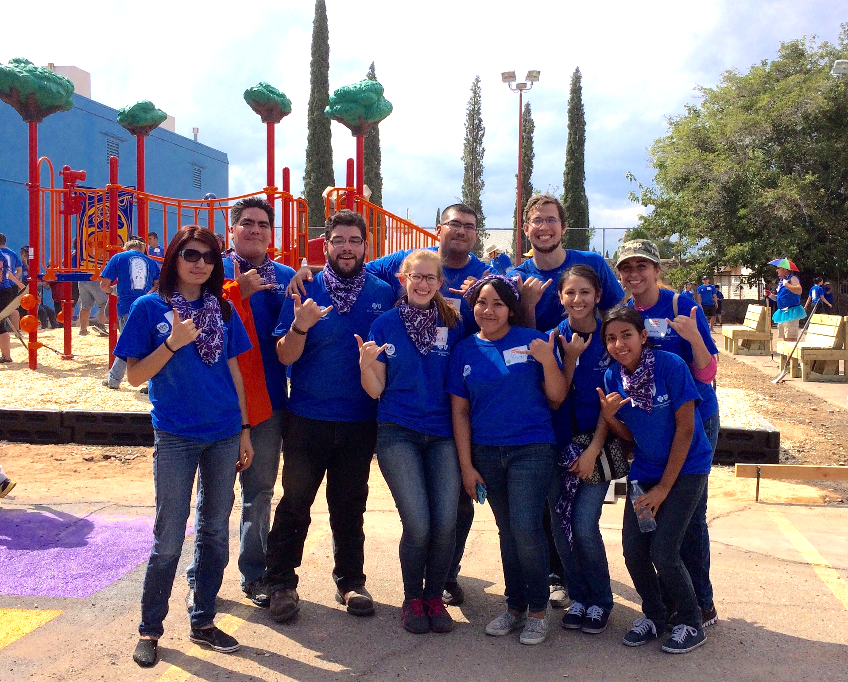

Slide 10
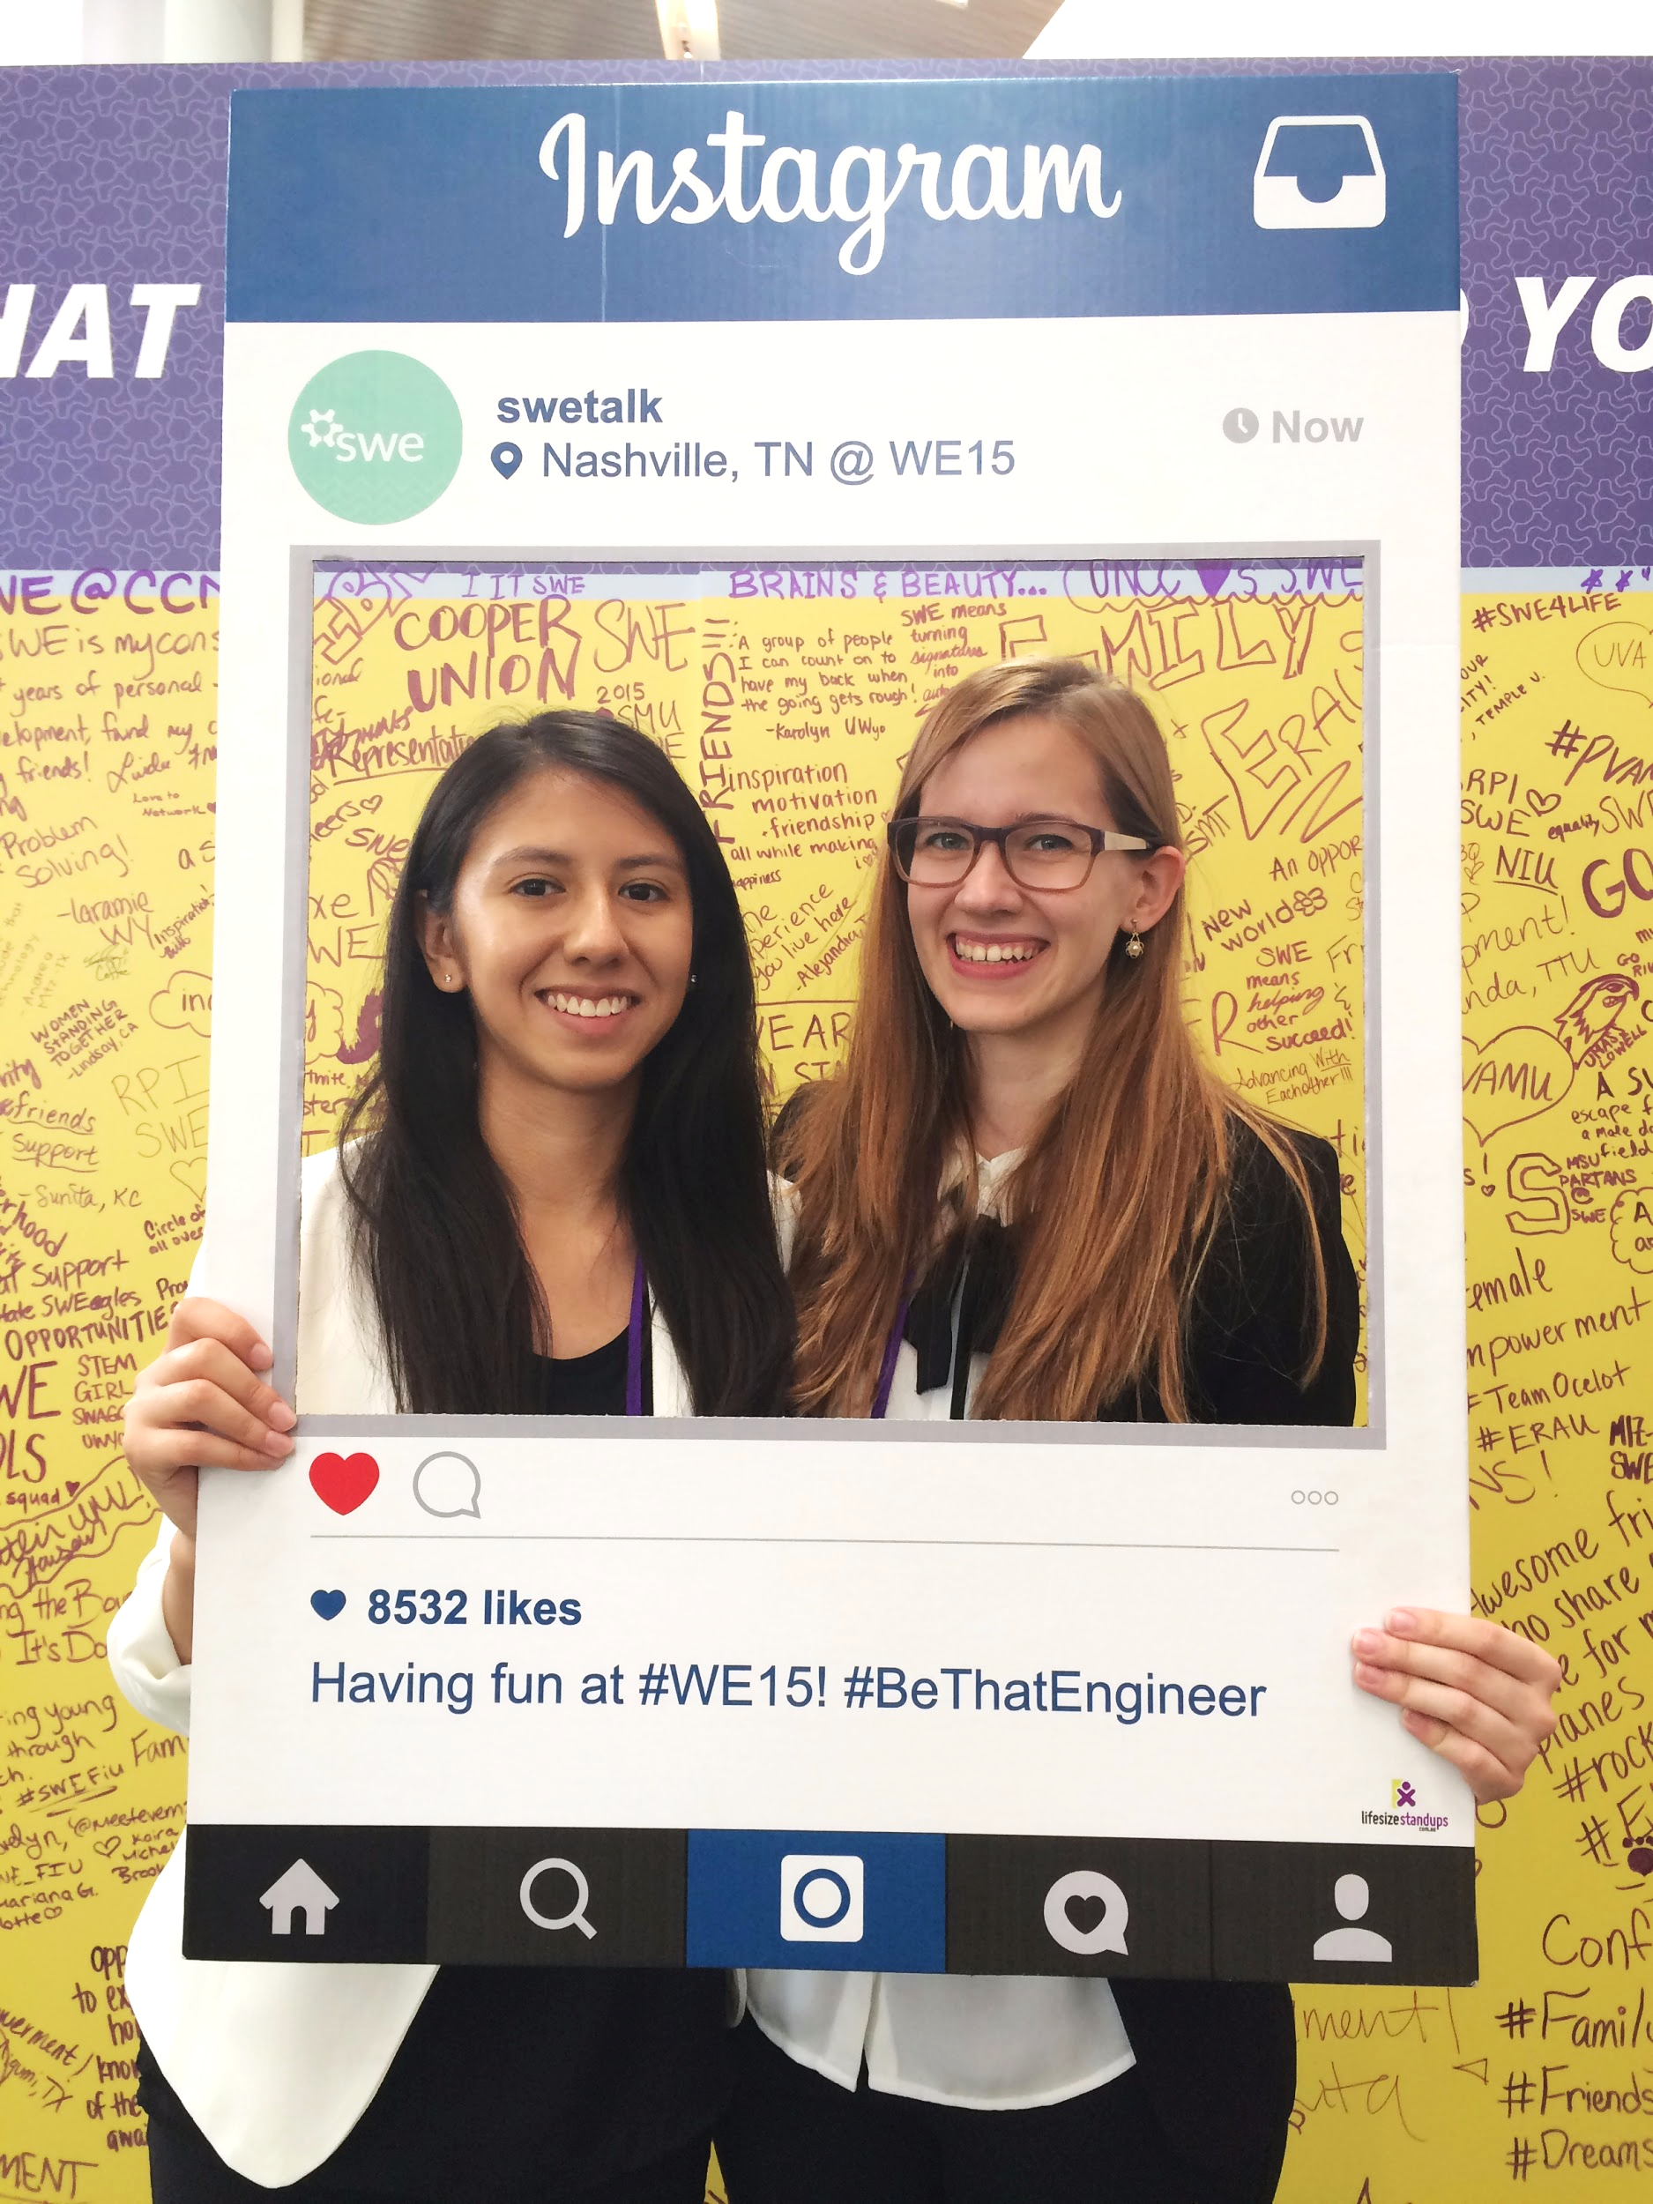
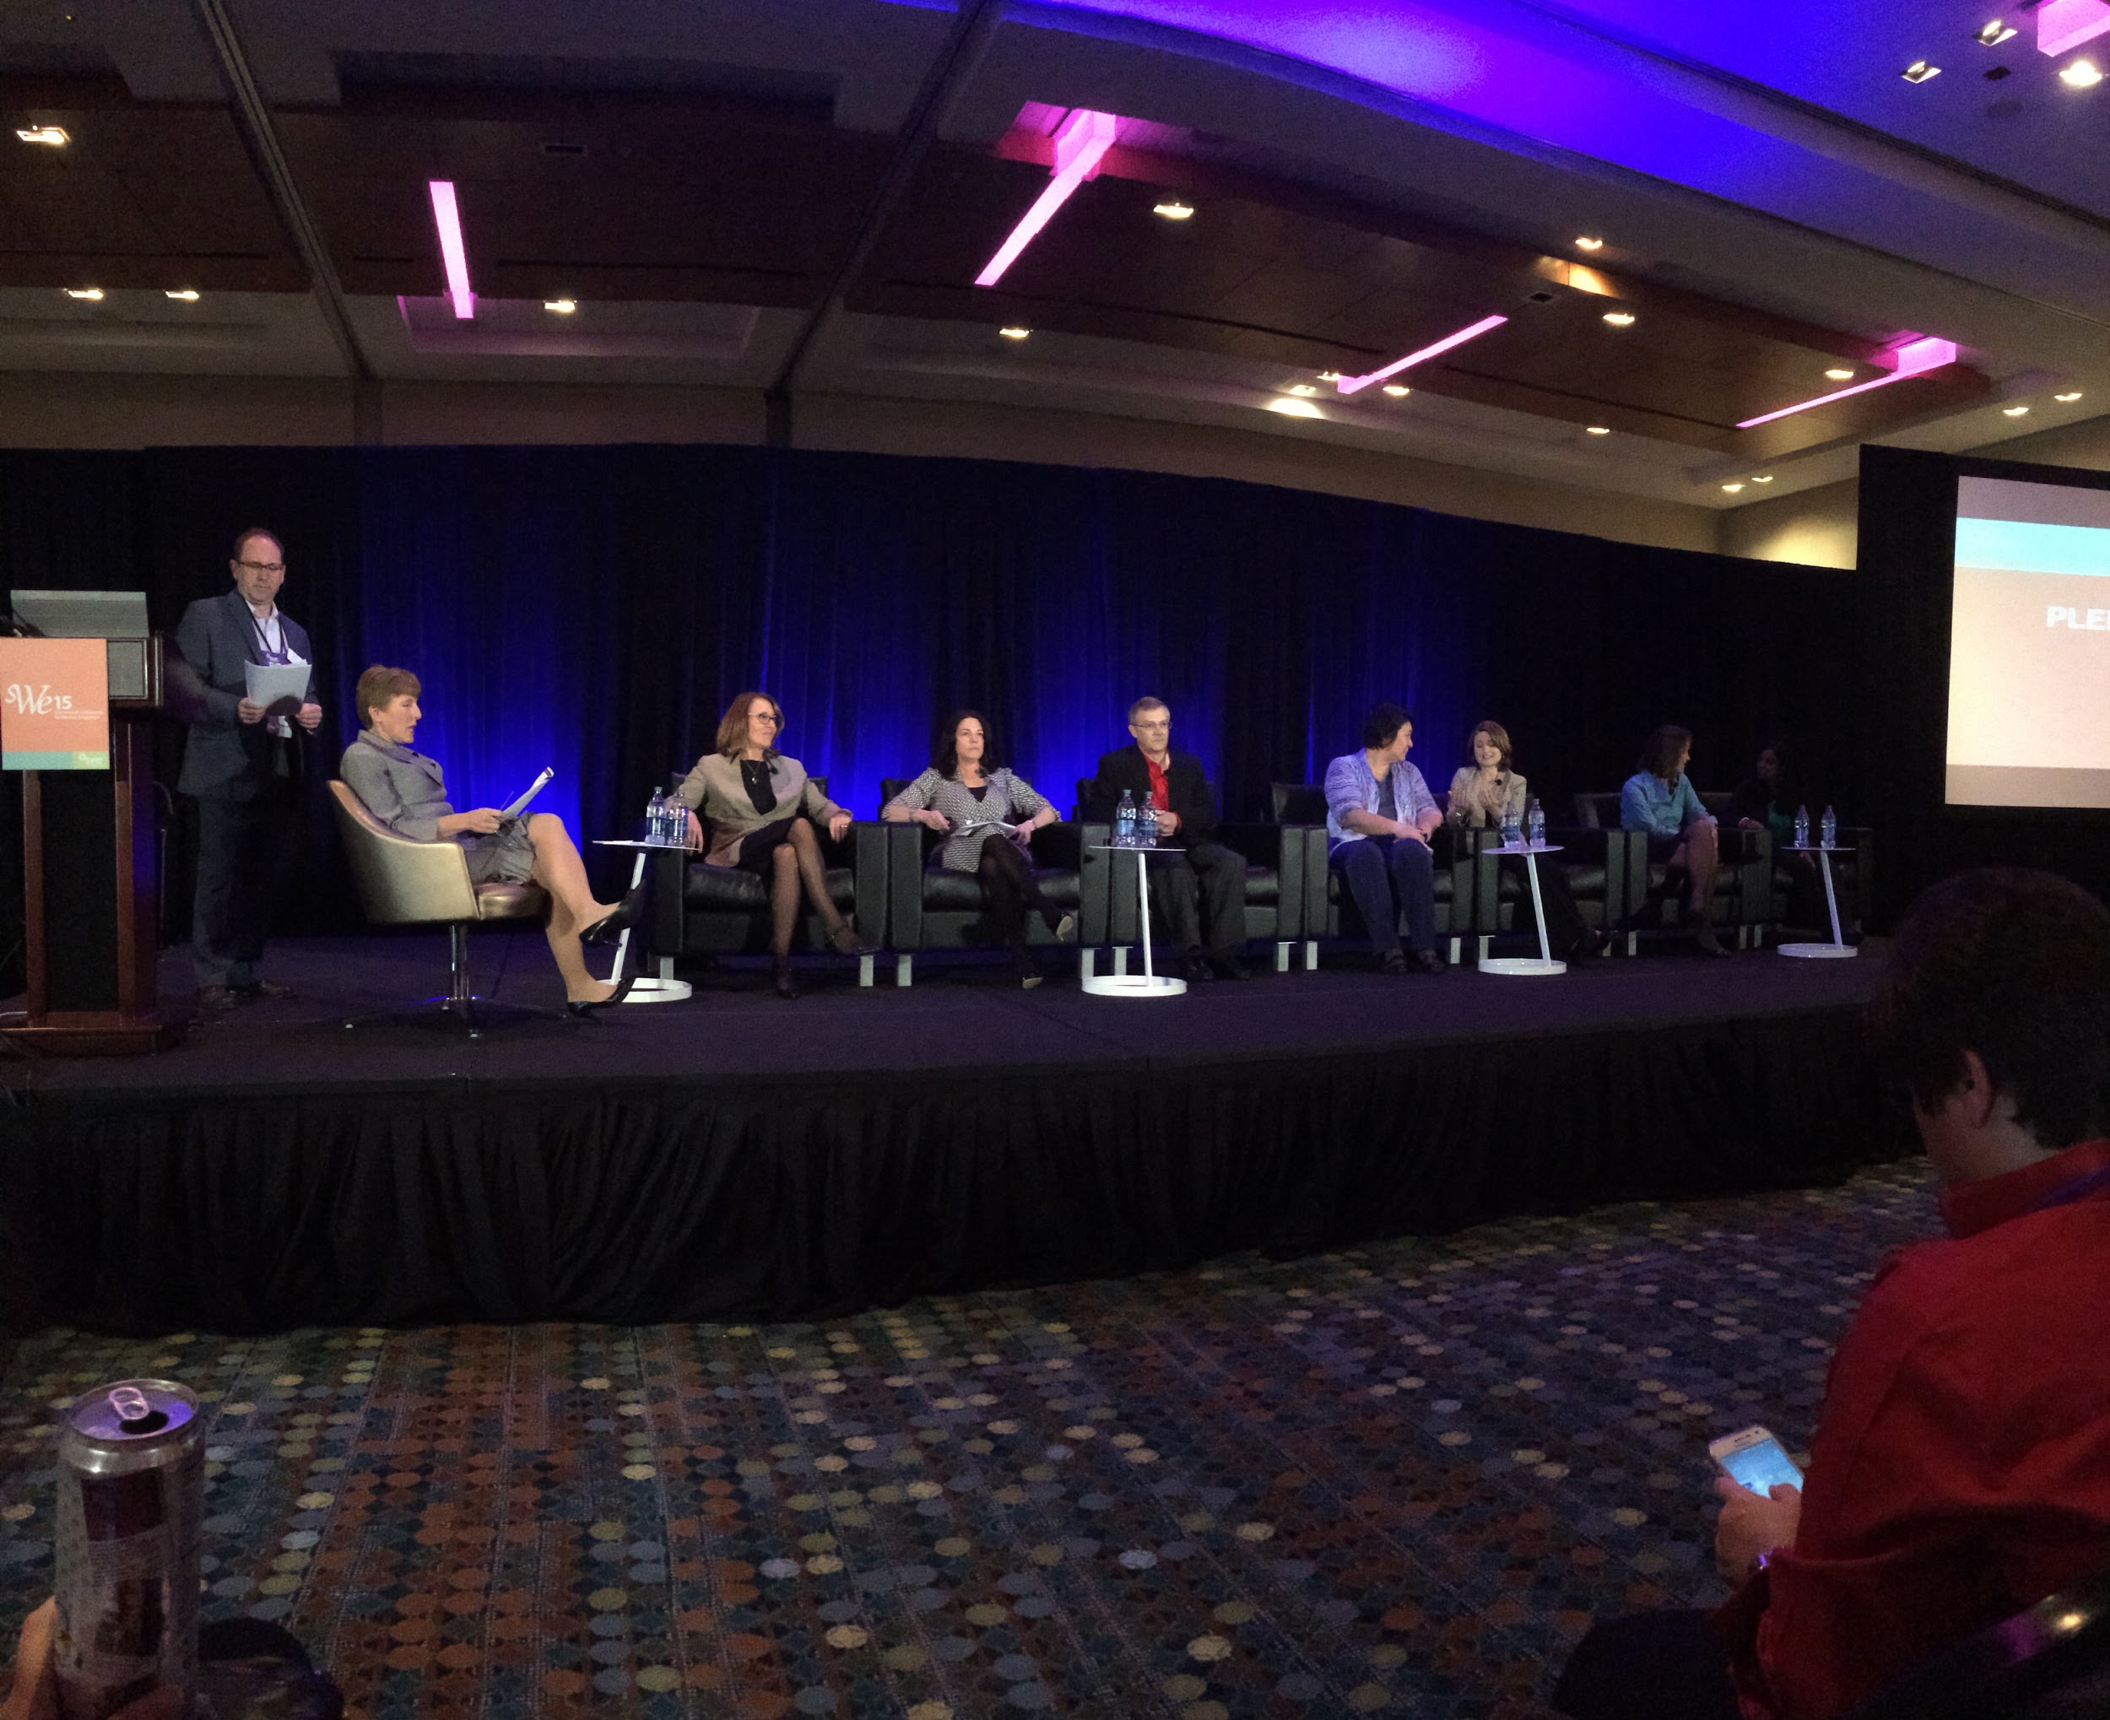
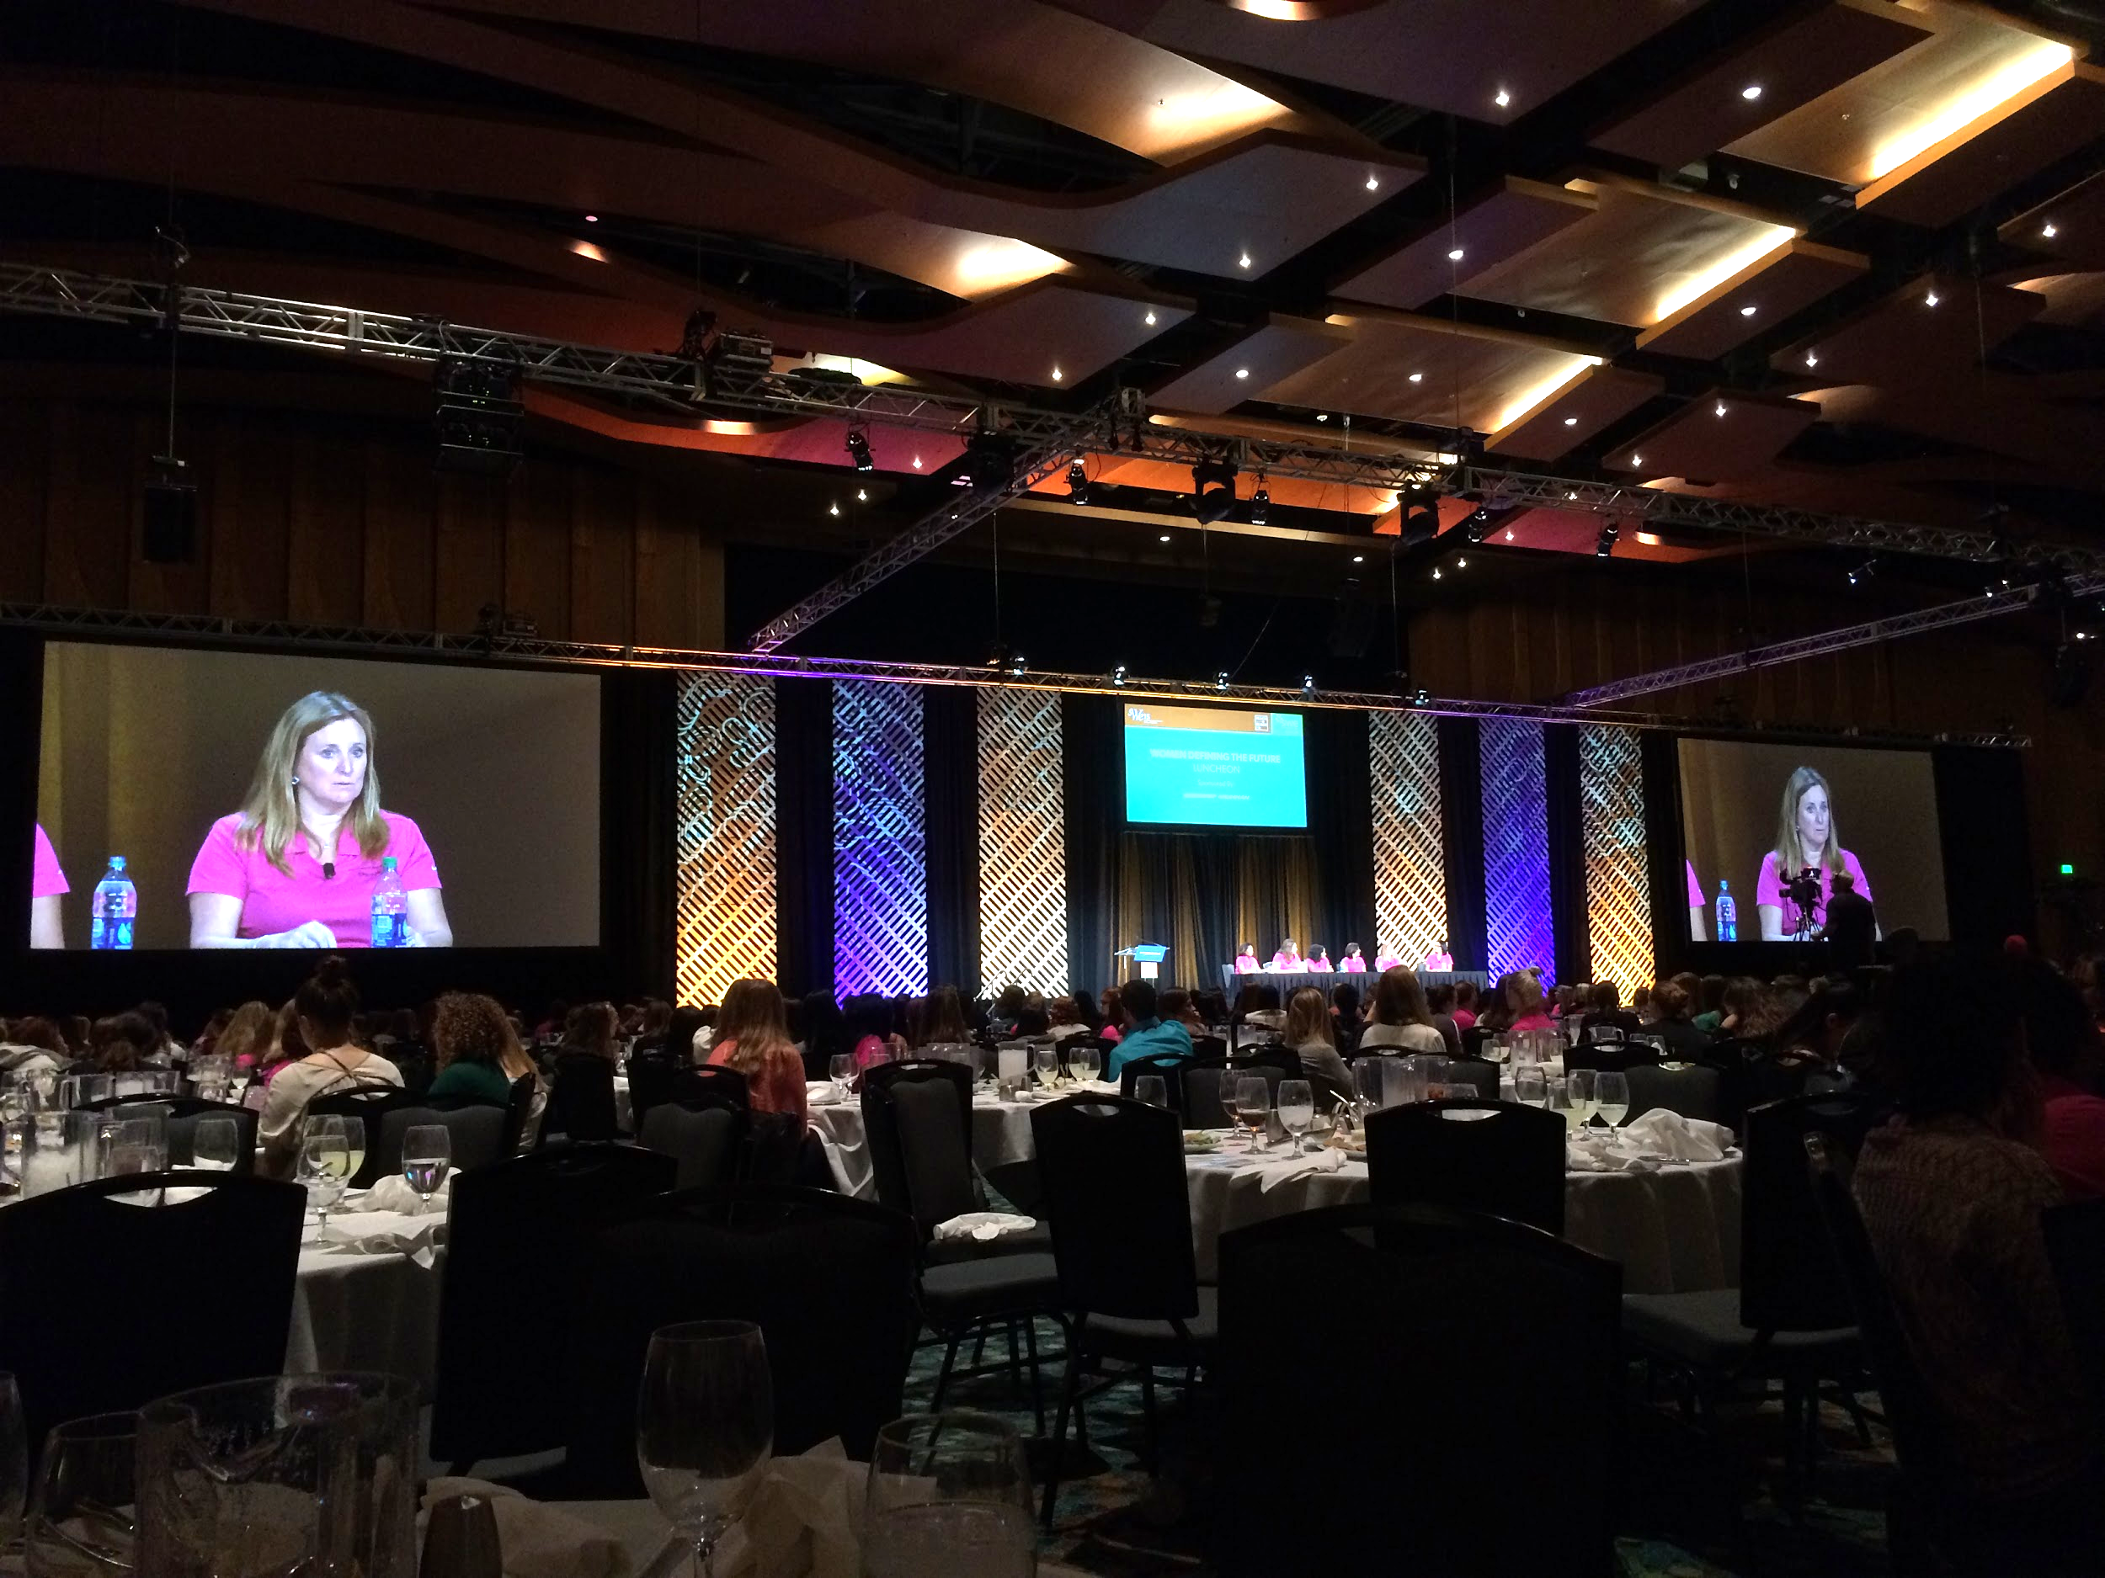


Slide 11
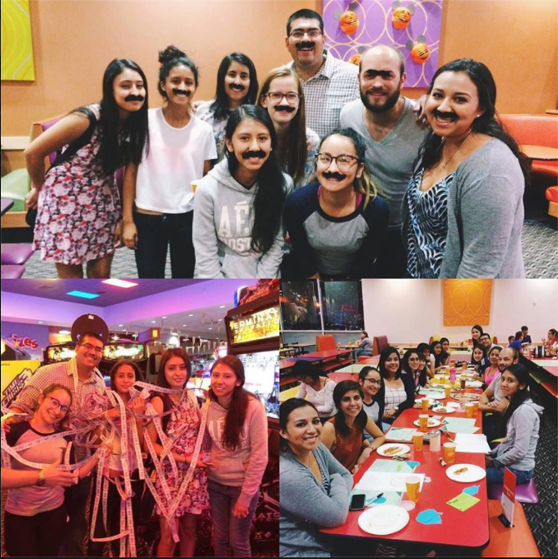

Slide 12
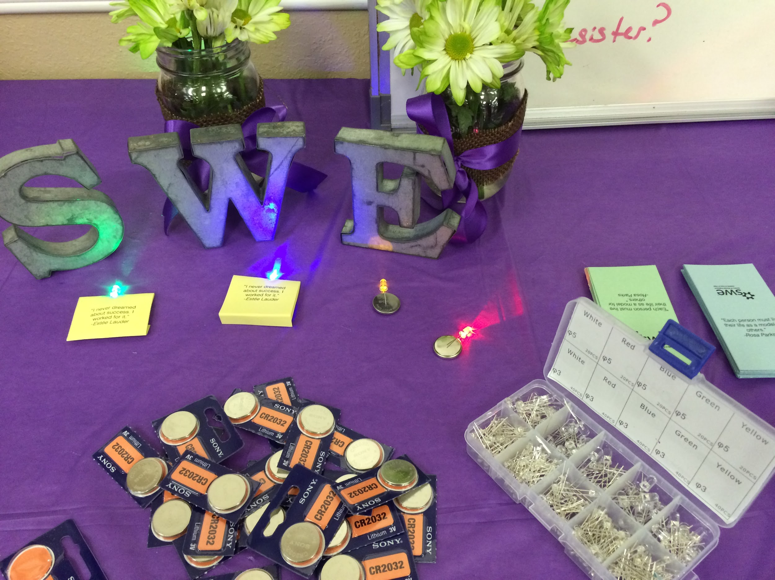
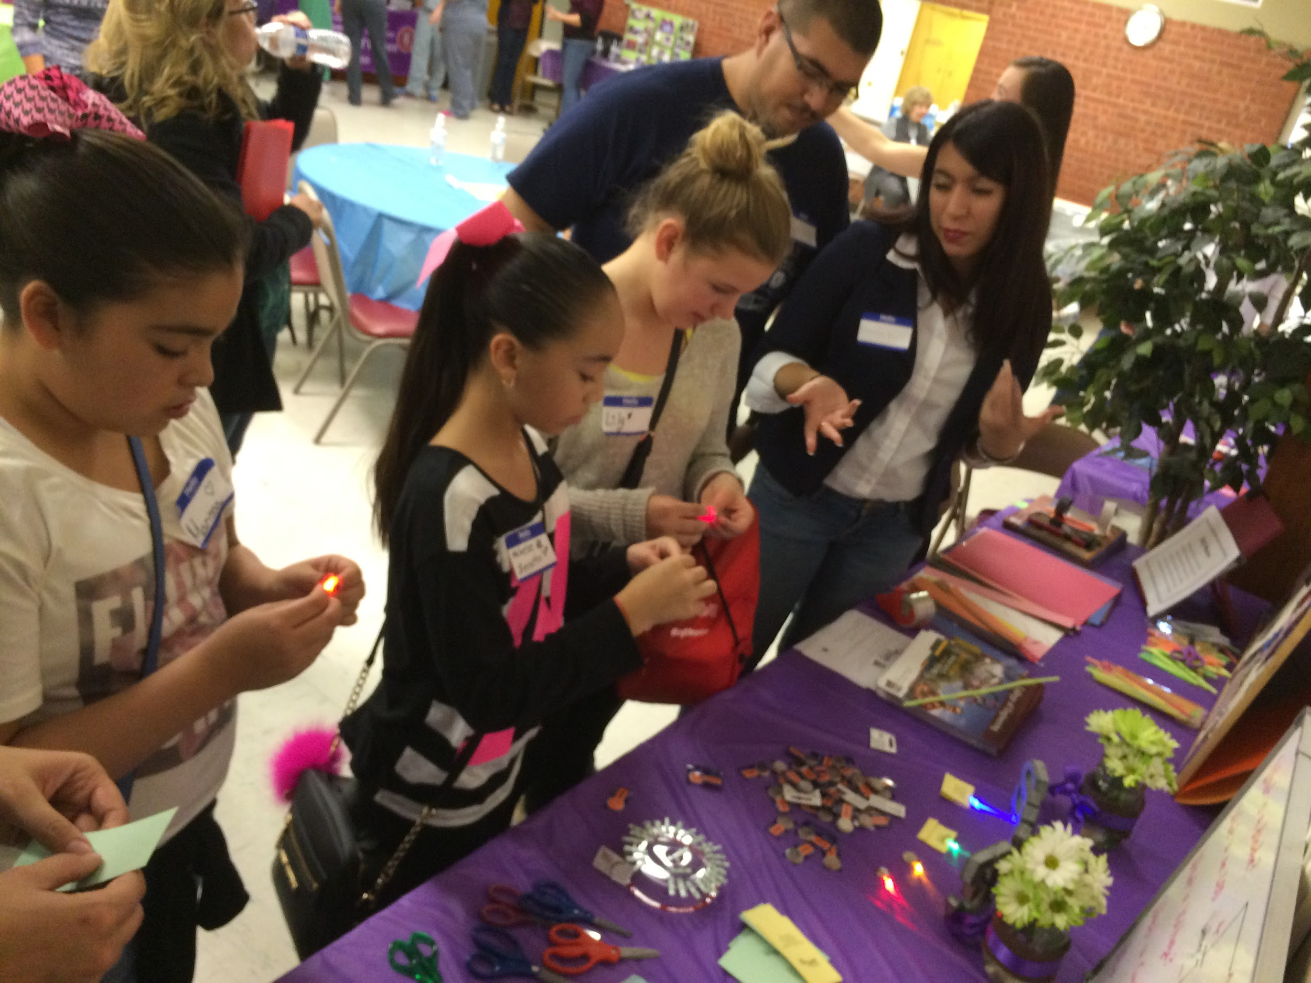
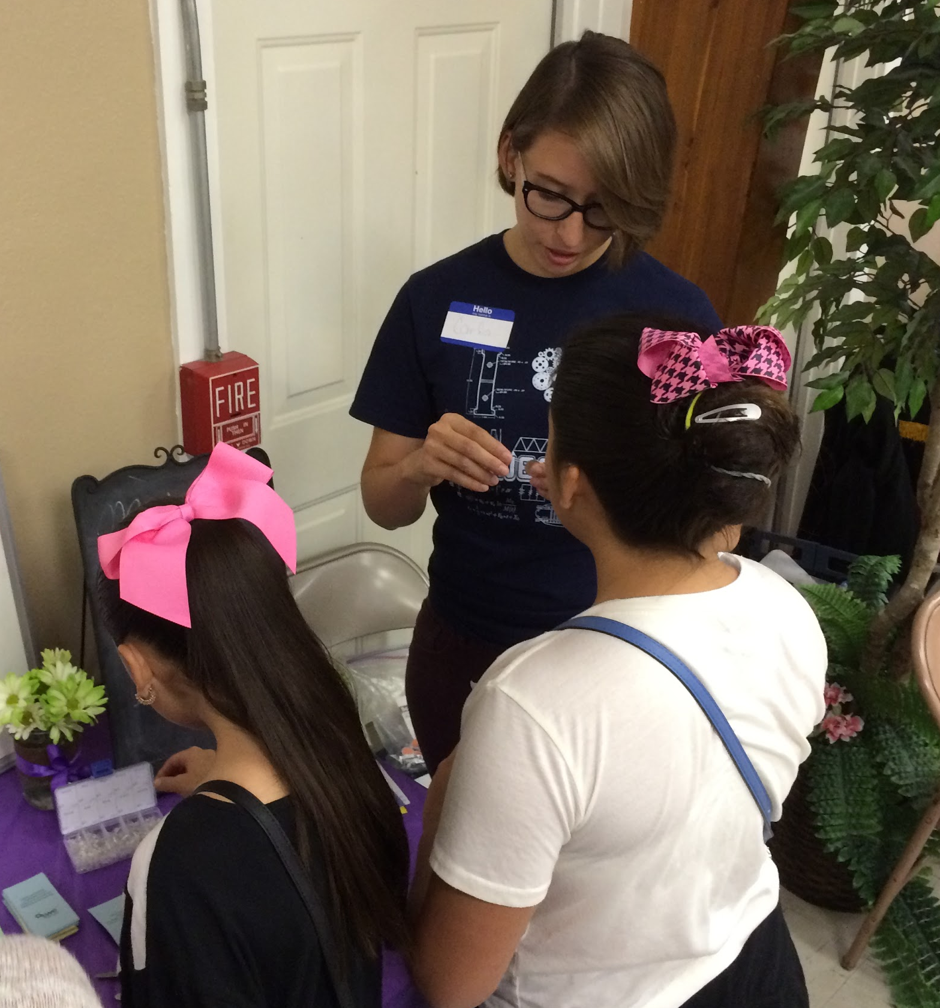
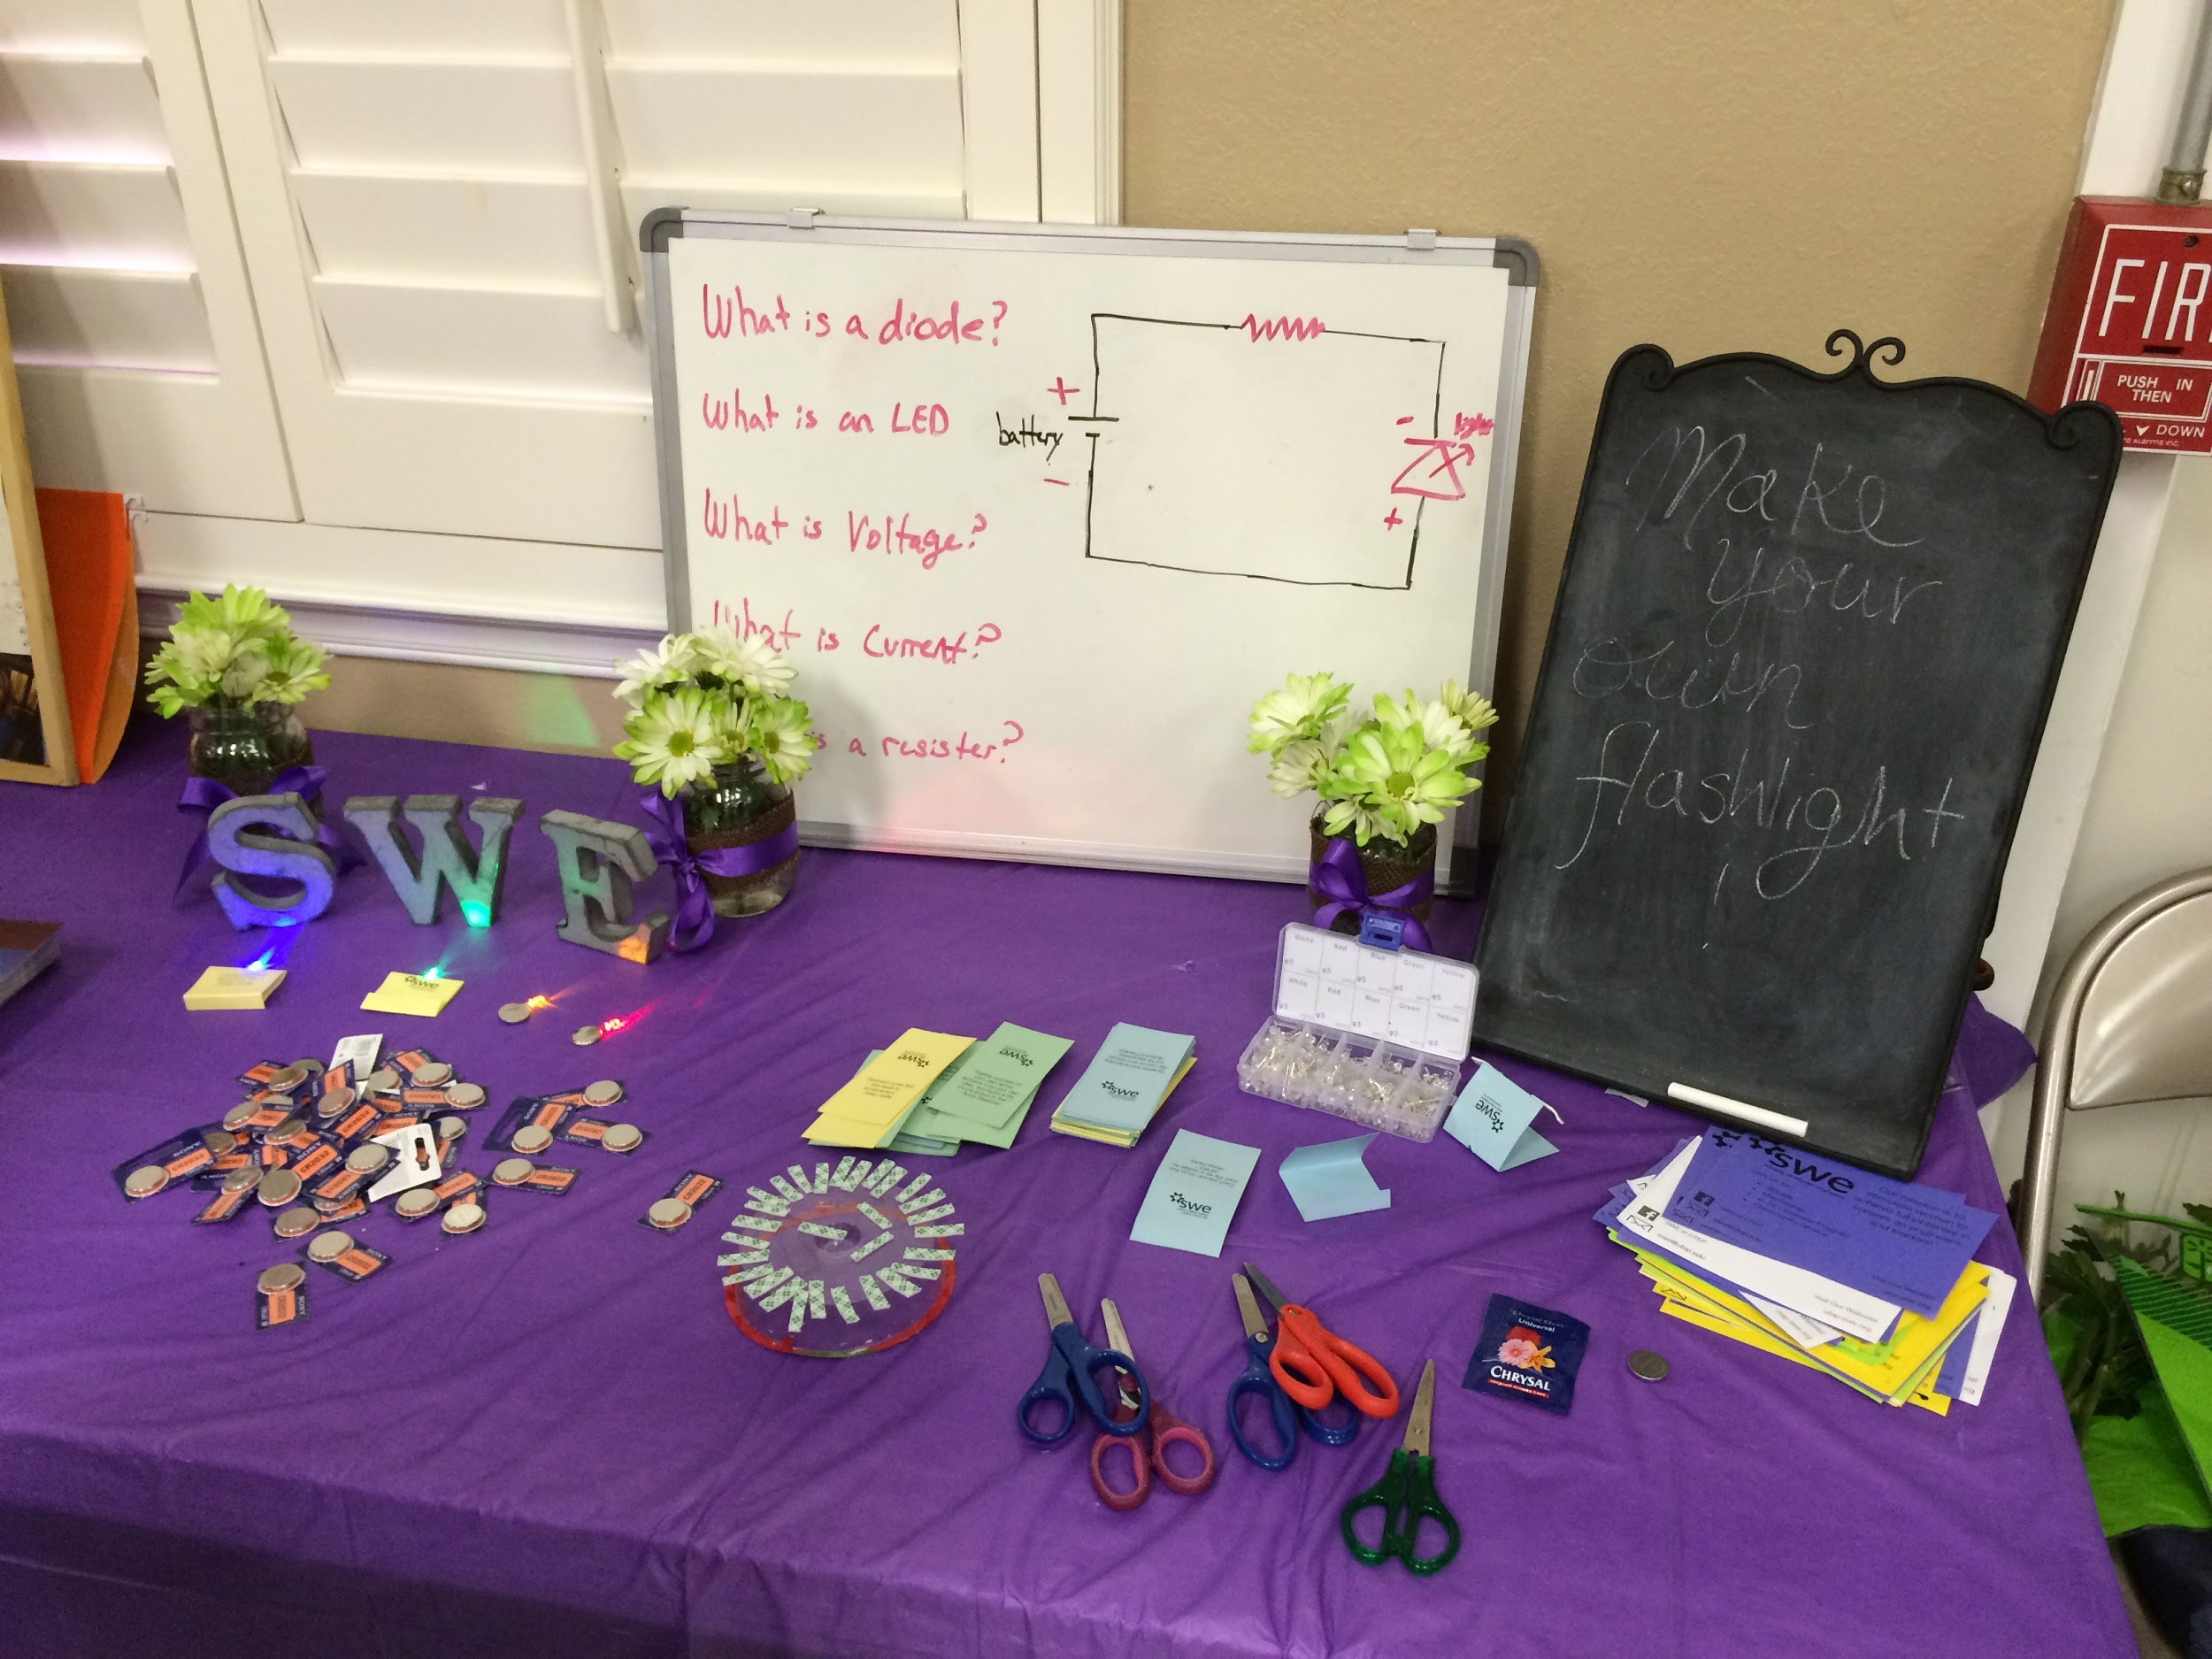

Slide 13
SWE Sibling Program
Announcements

Slide 14
Sibling Program
What is it?
  The purpose of the Big Sibling /Little Sibling Program is
  Provide support, advice, and guidance to freshmen, sophomore, and first-year transfer students in the College of Engineering
  Promote positive influence, motivation, and leadership in academia and personal life
  Ensure that all members maintain active roles within SWE
Notes:
Carla: I'm just going to say verbally about signing up and that we are going to have a social with info coming up….!

Slide 15

Sibling Program
  Sibling Leadership Seminar
  Wednesday November 18 @ 5 pm
  In ACES
Notes:
Heidi, would it be super easy to get aces?

Slide 16
Upcoming Events

Slide 17

Upcoming Events
Pick up your pre-ordered shirts!
Stop by the SWE office or as ACES staff for Heidi during the following times:
Monday & Wednesday: 9-3
Tuesday & Thursday: 10:30-3
Friday: 12-2:30

Slide 18

Upcoming Events
La Posada Christmas Party and Toy Drive!
Sign up :
Help us brighten a child's Christmas by purchasing a 10$- 20$ present for a child at the La Posada Home!
The last day to deliver your present at the SWE office will be Dead day

Slide 19
Upcoming Events
Mark your Calendars!
December 18 - Sibling Leadership seminar
December 4 - Please turn in your toy drive present by this day!
December 11 - Fall Semester graduation! Congrats seniors!
( please email us for your graduation stole)

Slide 20

What do you want to see next semester?

Slide 21


Thank you & Remember to like us on
&
SWE at UTEP
@swe_utep

