Slide 1
The Society of
Women Engineers
The University of Texas at El Paso
Second General Meeting
October 5th, 2016

Slide 2
Agenda
October 5, 2016
Who is SWE?
Thank you!
Icebreaker
Become a Member
Upcoming Events
Peas & Pods

Slide 3
Who is SWE?

Slide 4
Society of Women Engineers
Mission
“Stimulate women to achieve full potential in careers as engineers and leaders, expand the image of the engineering profession as a positive force in improving the quality of life, and demonstrate the value of diversity.”
Integrity • Inclusive Environment • Mutual Support
• Professional Excellence • Trust •

Slide 5
Goals
Mentorship
Community
Outreach
Community Service
Involvement

Slide 6
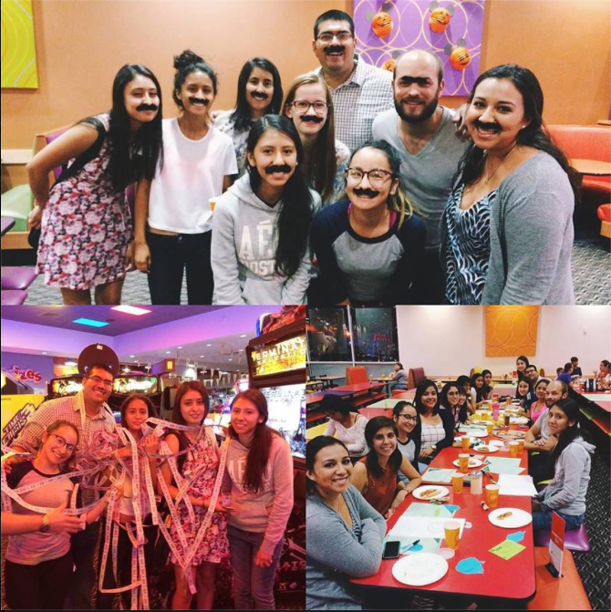
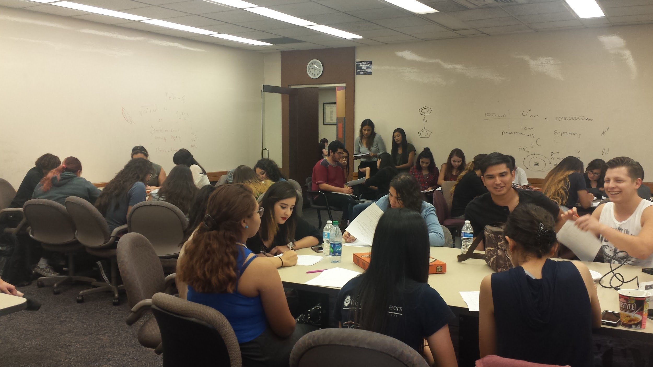
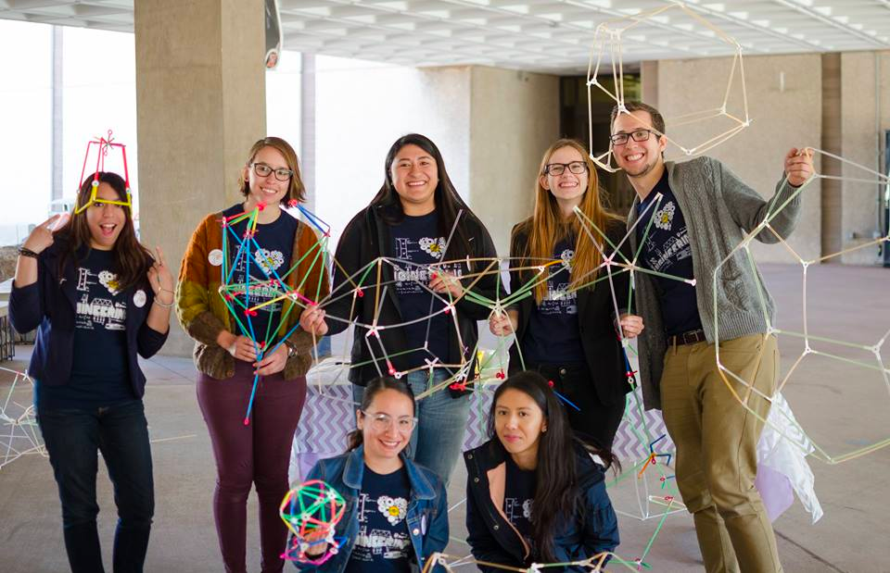
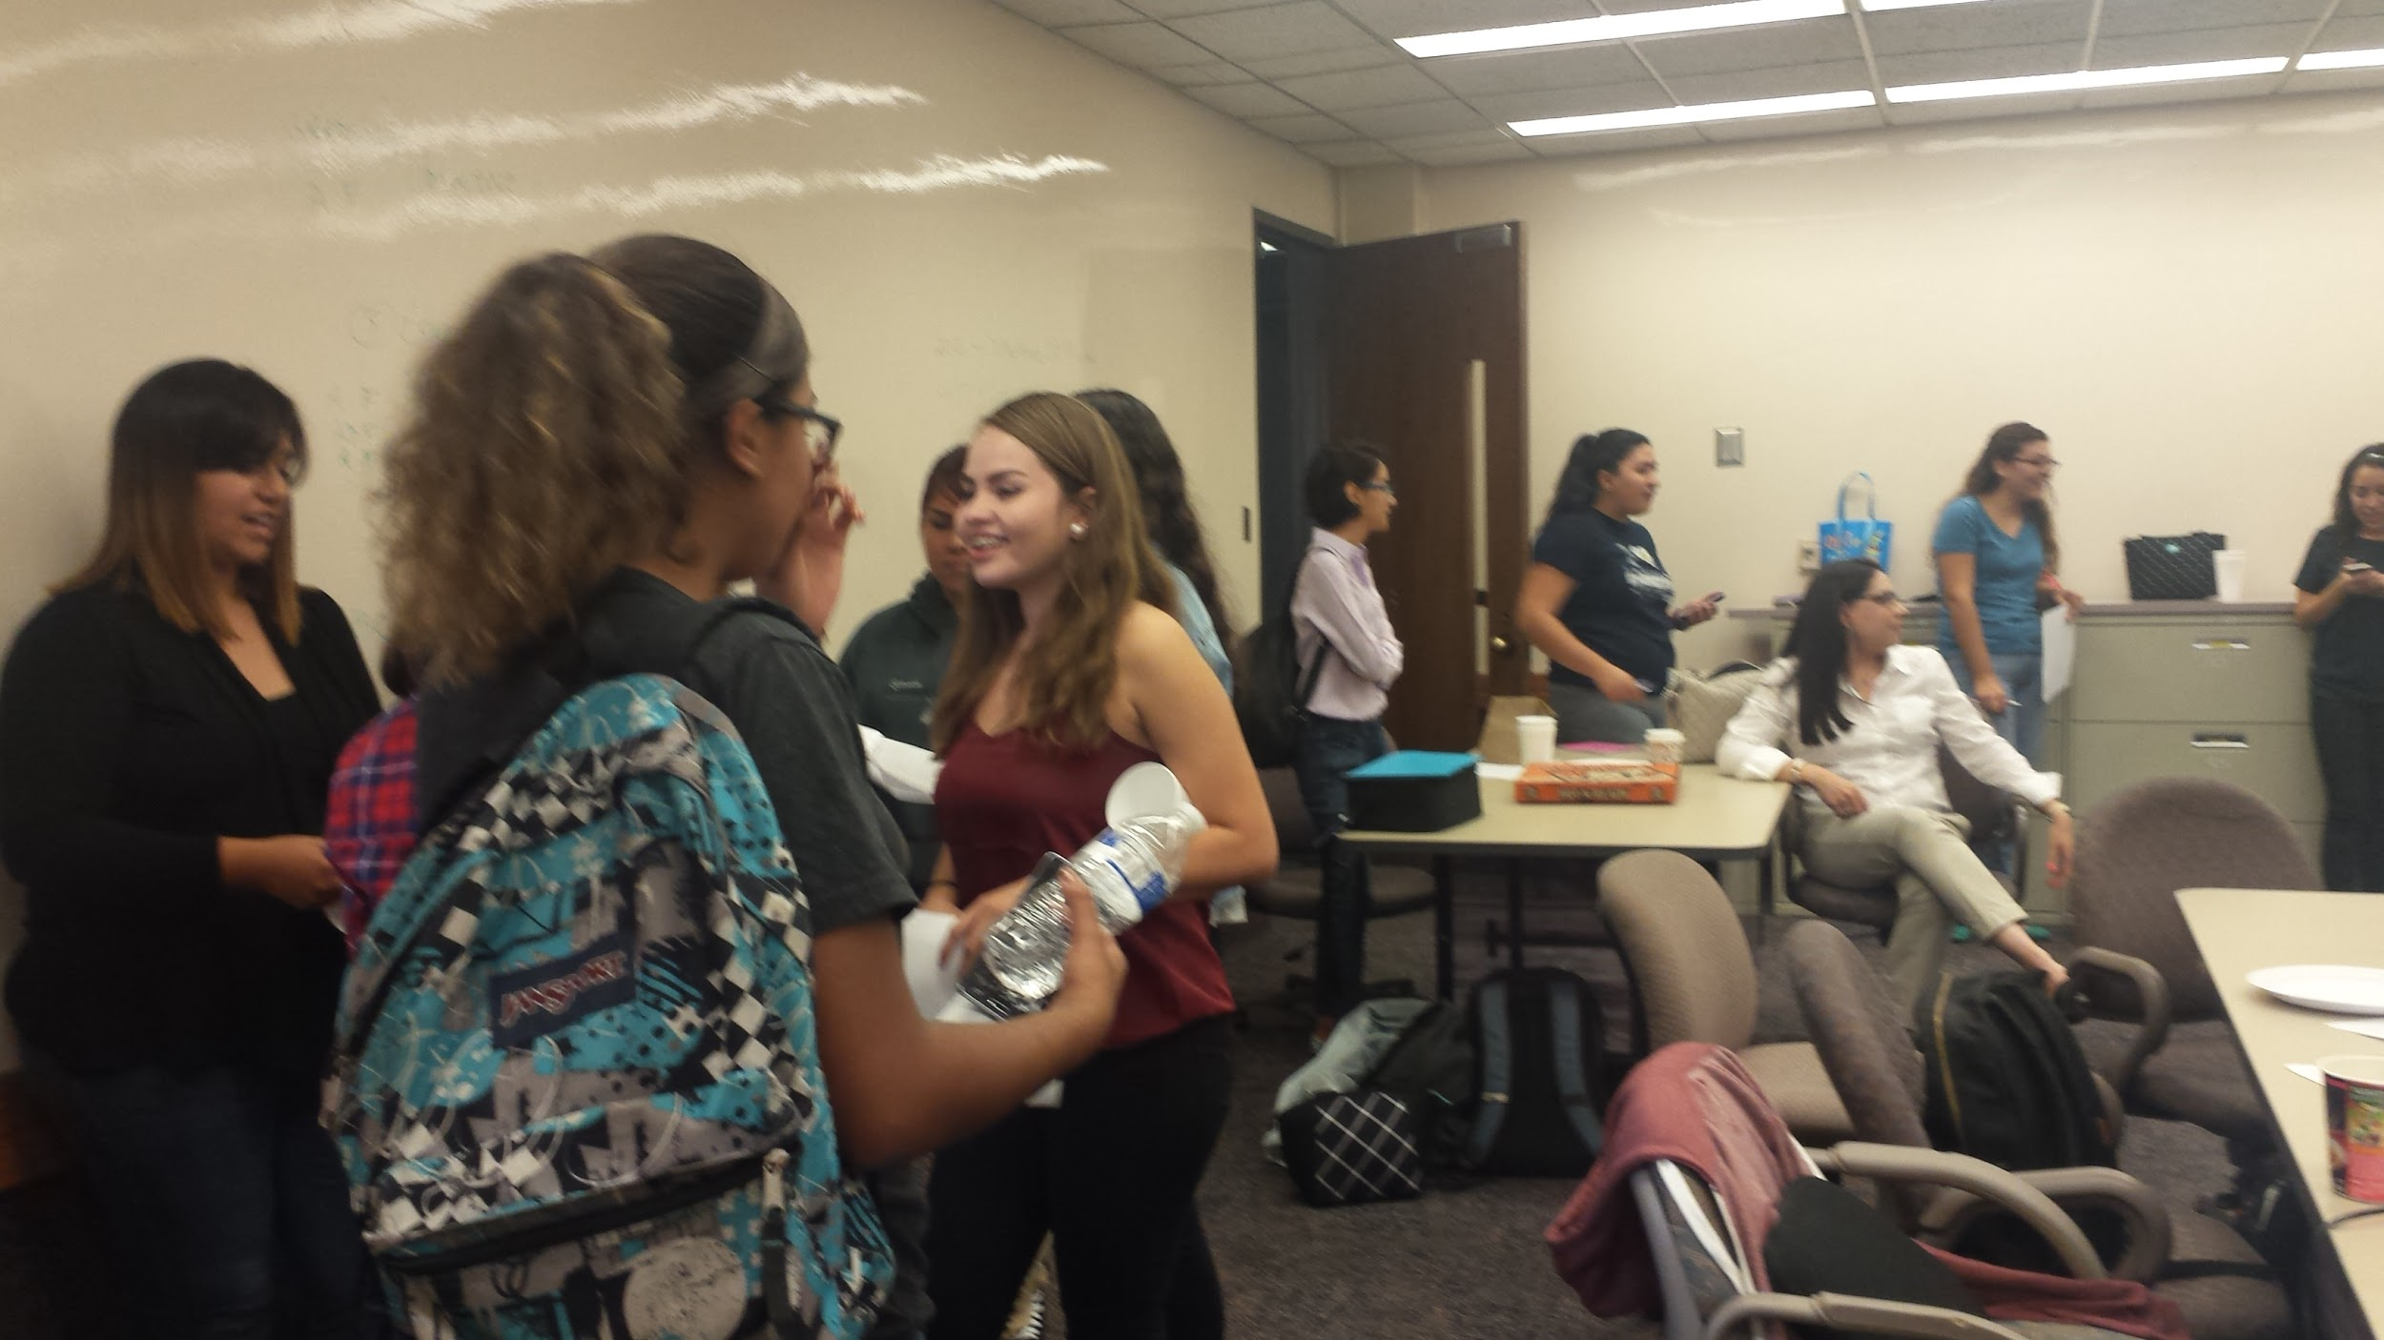

Slide 7
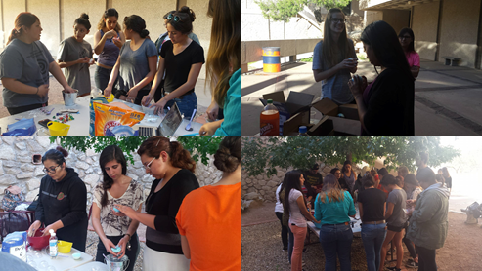
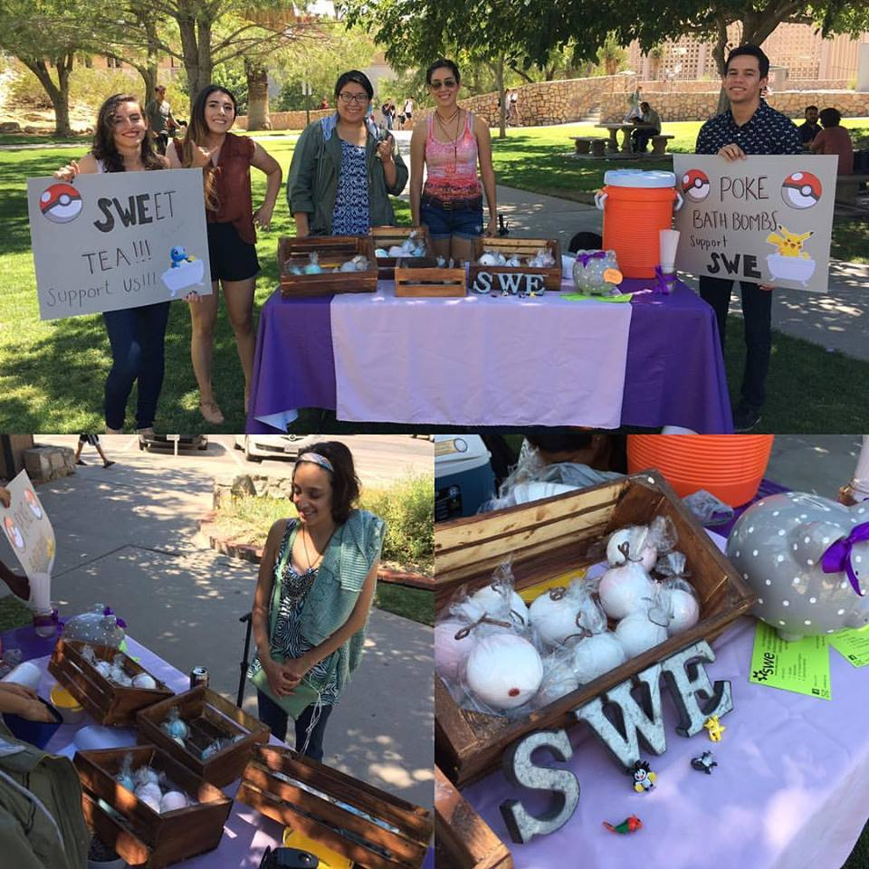

THANK YOU!!!!

Slide 8

Let's break the ice!
SWEet to Meet Yah!!!

Slide 9
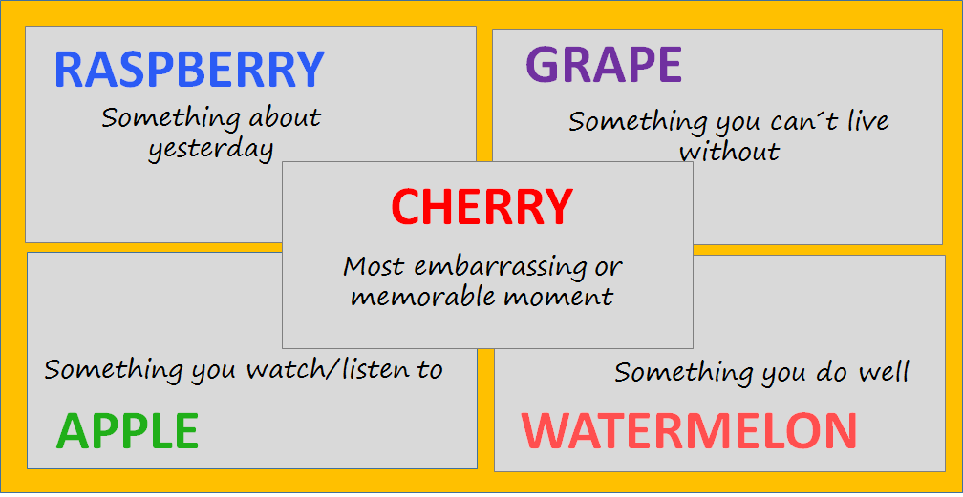

Let's break the ice!

Slide 10
Becoming a Member

Slide 11
Membership
In order to be in good standing, each member is required to:
Register with SWE National:
Membership for one year $20
Membership for 4 years + 1 professional year $50
2. Accumulate 10 hrs per semester
General Meetings
Socials
Volunteering
Info Sessions
Ect.
Why should I be in good standing?
Eligibility to receive graduation stole,
Eligibility to run for an officer position during elections,
Invitation to exclusive events. (ex. Spring Retreat)

Slide 12
SWENext Squad

Slide 13
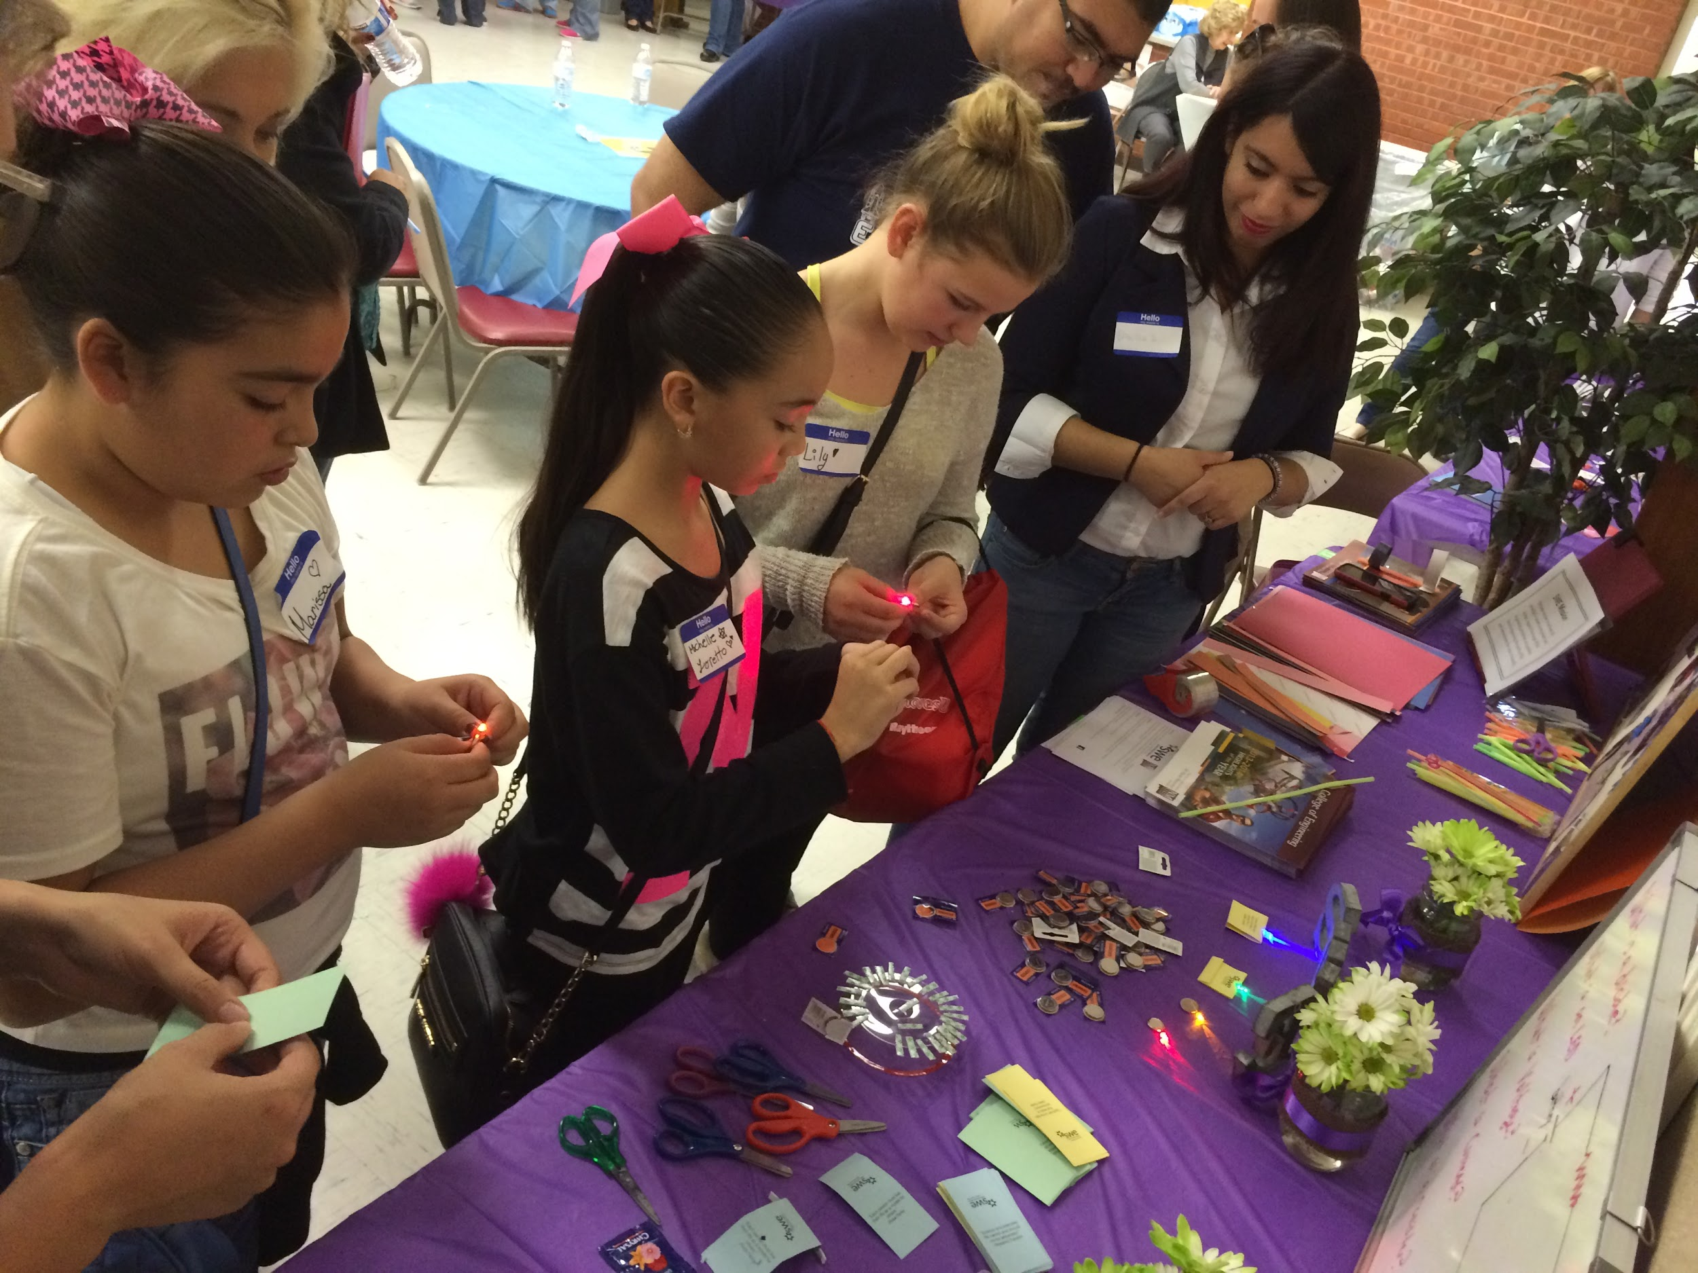
SWENext Squad
Join our core team of outreach volunteers!
SWE is looking to create a team of 10-12 volunteers to participate in developing outreach modules and activities as well as visiting schools and events.
This team is limited in size due background check and fingerprinting requirements.
Why should I join?
Add significant volunteering experience to your resume!
Be a part of encouraging the next generation of engineers!
Work with a team and have tons of fun!
Complete your SWE hours in an exciting way!
Free t-shirt!
Commitment:
15 Squad hours/year and 6 hours of training.
To join respond to Squad email sent later this week!

Slide 14
Upcoming Events

Slide 15

Upcoming Events
Thursday, October 6
1:30 pm-3:00 pm
Union East 102D

Slide 16


Upcoming Events
Ice Cream Social
Join us for a casual Ice Cream Social! Contribute by bringing your favorite topping to share or by donating $2 to the SWE Piggy Bank before Oct. 12th!
Thursday, October 13
4:30-6:30pm
ACES CLRB C-004

Slide 17

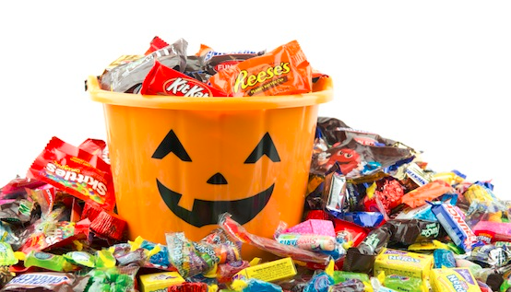
Upcoming Events
Candy Drive
Be part of our annual candy drive
We will be collecting candy to make candy bags
for the children at La Posada Home!
When: Oct.5-Oct.21
Where: SWE Office

Slide 18


Upcoming Events
Girl Powered Workshop
Eastwood High school is hosting the Girl Powered workshop to double the number of girls on robotics teams. SWE will be hosting an activity booth showcasing Strawbees and a 3D printing demo.
Tuesday, October 11th
10:00am-2:00pm
Eastwood High School
Sign up at:
https://goo.gl/forms/VT3wByhmpLJnoFQb2

Slide 19

Upcoming Events
Miracle League of El Paso Trunk or Treat
“The Miracle League of El Paso” is hosting Trunk or Treat event. Come out and help us decorate a car trunk, give out candy, and have lots of fun!
Saturday, October 29, 2016
Set up: 11 am-1pm
Event: 2 pm-5pm
Field of Miracles in Ponder Park, 7500 W. H Burges
Sign up HERE

Slide 20

Upcoming Events
Volunteering Events
Indicate your volunteer preferences at: http://stairs.utep.edu/volunteer-information/
Volunteers will receive a certificate of presentation, a tote bag with gifts and entry into raffles for prizes.
For more information go to: http://stairs.utep.edu/
Questions? Contact Barbara Schoen at 915-747-7233 or baschoen@utep.edu
Student Annual Interdisciplinary Research Symposium (STAIRS)
Friday, October 7th from 12:00pm – 4:30pm
@ The Tomás Rivera Conference Center in UTEP’s Union East
FLL Referee/Judges Training
October 29, 2016
9:00am to 1:00pm
SISD District Service Center, 12440 Rojas Dr, El Paso, TX 79928
FLL Championship
January 21, 2017
8:00am~6:00pm
UTEP Campus, Memorial Gym (see building #201 on map)

Slide 21

Upcoming Events
Mark your Calendars!
Oct. 6: Internship Panel
Oct. 7: Student Annual Interdisciplinary Research Symposium (STAIRS)
Oct. 11: Girl Powered
Oct. 13: Ice Cream Social
Oct. 21: Last day to donate candy
Oct. 27-29: WE16 Conference
Oct. 29 Miracle League of El Paso Trunk or Treat
Nov. 4: Bahama Bucks Fundraiser (Date subject to change)

Slide 22
Peas & Pods

Slide 23

Peas & Pods
Pods exist to provide all members with a community group where they can study together, hang out and support each other. Each pod will be assigned an officer POC.
Prizes will be awarded at the end of the year to the pod that accumulates the most hours.
Encourage your pod to stay involved!
Go say hi to your POD!

Slide 24
Questions???

Slide 25


Thank you & Remember to like us on
&
SWE at UTEP
@swe_utep

